Slide 1

INSTITUTE : UIE
DEPARTMENT : CSE
Bachelor of Engineering (Computer Science & Engineering)
Mobile Application Development(20CST-355)
TOPIC OF PRESENTATION:
App user Interface Designing, Layout, User Interface elements, Draw-able, Menu
Prepared by:
Parveen Kumar Saini(E13339)
DISCOVER . LEARN . EMPOWER

Slide 2
Layouts

Slide 3
Layout Views
Layouts
are specific types of view groups
are subclasses of ViewGroup
contain child views
can be in a row, column, grid, table

Slide 4




Common Layout Classes
LinearLayout
RelativeLayout
GridLayout
TableLayout

Slide 5
Common Layout Classes
ConstraintLayout - connect views with constraints
LinearLayout - horizontal or vertical row
RelativeLayout - child views relative to each other
TableLayout - rows and columns
FrameLayout - shows one child of a stack of children
GridView - 2D scrollable grid

Slide 6
Layout created in XML
<LinearLayout
android:orientation="vertical"
android:layout_width="match_parent"
android:layout_height="match_parent">
<EditText
... />
<Button
... />
</LinearLayout

Slide 7
Layout created in Java Activity code
LinearLayout linearL = new LinearLayout(this);
linearL.setOrientation(LinearLayout.VERTICAL);
TextView myText = new TextView(this);
myText.setText("Display this text!");
linearL.addView(myText);
setContentView(linearL);

Slide 8
Setting width and height in Java code
Set the width and height of a view:
LinearLayout.LayoutParams layoutParams =
new Linear.LayoutParams(
LayoutParams.MATCH_PARENT, LayoutParams.WRAP_CONTENT);
myView.setLayoutParams(layoutParams);

Slide 9
Events
Something that happens
In UI: Click, tap, drag
Device: DetectedActivity such as walking, driving, tilting
Events are "noticed" by the Android system

Slide 10
Event Handlers
Methods that do something in response to a click
A method, called an event handler, is triggered by a specific event and does something in response to the event

Slide 11
Handling clicks in XML & Java
Attach handler to view in layout:
android:onClick="showToast"
Implement handler in activity:
public void showToast(View view) {
String msg = "Hello Toast!";
Toast toast = Toast.makeText(
this, msg, duration);
toast.show();
}
}

Slide 12
Setting click handlers in Java
final Button button = (Button) findViewById(R.id.button_id);
button.setOnClickListener(new View.OnClickListener() {
public void onClick(View v) {
String msg = "Hello Toast!";
Toast toast = Toast.makeText(this, msg, duration);
toast.show();
}
});

Slide 13
Resources
Separate static data from code in your layouts.
Strings, dimensions, images, menu text, colors, styles
Useful for localization

Slide 14
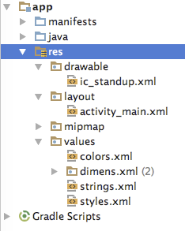
Where are the resources in your project?
resources and resource files
stored in res folder

Slide 15
Refer to resources in code
Layout:
R.layout.activity_main
setContentView(R.layout.activity_main);
String:
In Java: R.string.title
In XML: android:text="@string/title"

Slide 16
Measurements
Device Independent Pixels (dp) - for Views
Scale Independent Pixels (sp) - for text
Don't use device-dependent units:
Actual Pixels (px)
Actual Measurement (in, mm)
Points - typography 1/72 inch (pt)

Slide 17
Views, Layouts, and Resources

Slide 18
Contents
Contents
Views, view groups, and view hierarchy
Layouts in XML and Java code
Event Handling
Resources
Screen Measurements

Slide 19
Views

Slide 20
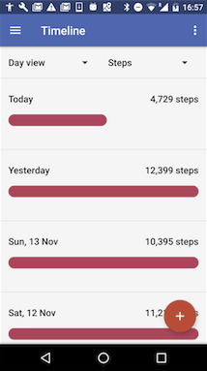
Everything you see is a view
If you look at your mobile device,
every user interface element that you see is a View.
Views

Slide 21
What is a view
Views are Android's basic user interface building blocks.
display text (TextView class), edit text (EditText class)
buttons (Button class), menus, other controls
scrollable (ScrollView, RecyclerView)
show images (ImageView)
subclass of View class

Slide 22
Views have properties
Have properties (e.g., color, dimensions, positioning)
May have focus (e.g., selected to receive user input)
May be interactive (respond to user clicks)
May be visible or not
Have relationships to other views

Slide 23
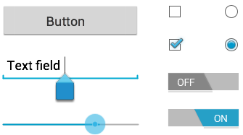
Examples of views
Button
EditText
SeekBar
CheckBox
RadioButton
Switch

Slide 24
Creating and laying out views
Graphically within Android Studio
XML Files
Programmatically

Slide 25
What is the context?
Context is an interface to global information about an application environment
Get the context:
Context context = getApplicationContext();
An activity is its own context: TextView myText = new TextView(this);

Slide 26
Custom views
Over 100 (!) different types of views available from the Android system, all children of the View class
If necessary, create custom views by subclassing existing views or the View class

Slide 27
ViewGroup & View Hierarchy

Slide 28
ViewGroup views
A ViewGroup (parent) is a type of view that can contain other views (children)
ViewGroup is the base class for layouts and view containers
ScrollView—scrollable view that contains one child view
LinearLayout—arrange views in horizontal/vertical row
RecyclerView—scrollable "list" of views or view groups

Slide 29
Hierarchy of view groups and views
ViewGroup
Root view is always a view group
ViewGroup
View
View
View
View
View

Slide 30
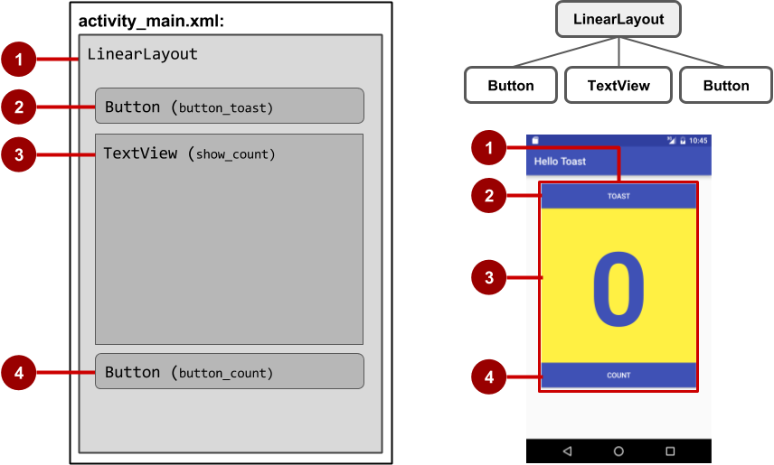
View hierarchy and screen layout

Slide 31
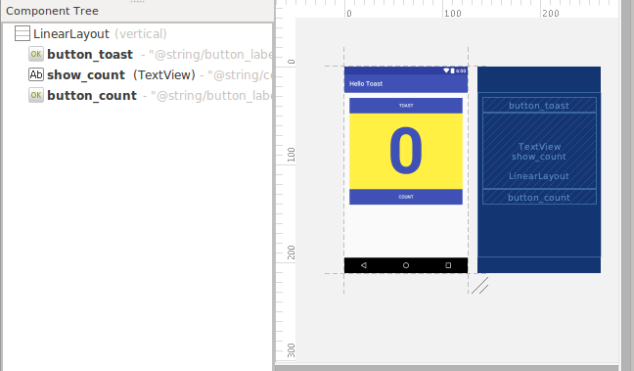
View hierarchy in the component tree

Slide 32
Practice problem
Reference books: Professional Mobile Application Development
Teach Yourself Android Application Development in 24 Hrs
LINK OF VIDEO: https://www.youtube.com/watch?v=TwXuY2w7Zv0 ( Tutorial Point)
LINK OF VIDEO: https://www.youtube.com/watch?v=t38wfcfm1E4 ( Seton Hall University)
https://www.tutorialspoint.com/android/android_ui_design.htm
https://www.geeksforgeeks.org/android-ui-layouts/

Slide 33
THANK YOU
For queries
Email: parveen.e13339@cumail.in

